Slide 1
Programming for Life Scientists
Winfred Gatua
01/05/2021

Slide 2
Objectives
Git and GitHub
Linux
High Performance Computing
Conda and Jupyter notebook
Python

Slide 3
Git and GitHub
Git – used for version control
GitHub –host the services
Practicing Markdown
This is a hands on class and here is the reference material

Slide 4
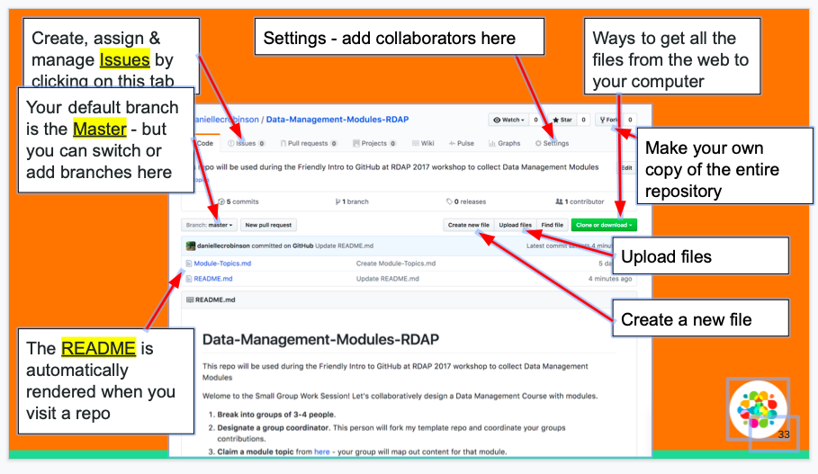

Slide 5
Linux
It refers to a generic term referring to Unix-like GUI based computer operating systems
Its multiuser, multitasking, multiprocessor
Has Windows like GUI
It coexists with other operating systems (OS)
Runs on multiple platforms
OS – allows communication between computer hardware and the software

Slide 6
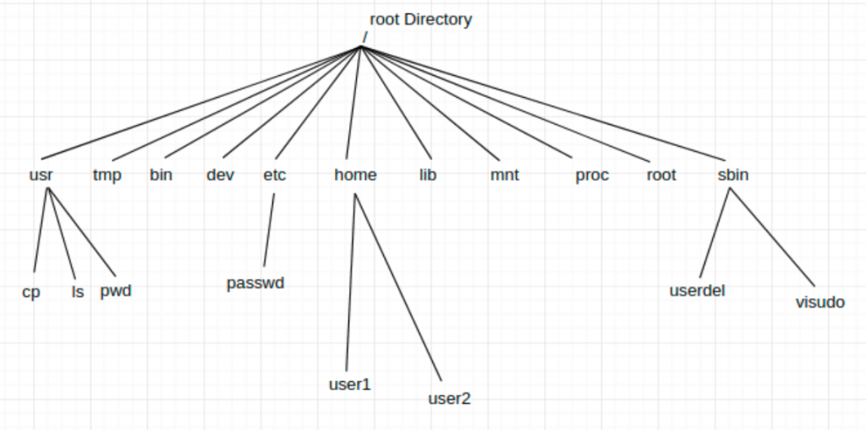
Linux File system

Slide 7
Basic Linux Commands
File handling
Text processing
System administration
File systems
Advanced commands

Slide 8
How to learn commands
There are two ways you can approach this:
Man (Manual) pages
Man <command>
<Command> help

Slide 9
File Handling Commands
Mkdir – make directories
Usage: mkdir [OPTION] DIRECTORY…
ls- list directory contents
Usage: ls [OPTION]… [FILE]..
Cd – change directories
Usage: cd [DIRECTORY]

Slide 10
Continue
Pwd – print name of current working directory
Usage: pwd
Vim- Vi improved, a programmers text editor
Usage: vim [option] [file]
#alternatively
Nano [OPTIONS]
NB: Never write any code on Microsoft word instead use text editors

Slide 11
Continue
Cp- copy files and directories
Usage: cp [OPTION]… SOURCE DEST
Mv – move (rename) files
Usage: mv [OPTION]… SOURCE DEST
Rm –remove files or directory (No recycle bin)
Usage: rm [OPTION]… FILE
Find – search for files in a directory hierarchy
Usage: find [OPTION] [PATH] {PATTERN]
History- prints recently used commands
Usage: history

Slide 12
Text processing
Cat – concatenate files and print on the standard output
Usage: cat [OPTION] [FILE]
Echo- display a line of text
Usage: echo [OPTION] [string]
Grep print lines matching a pattern
Usage: grep [OPTION] PATTERN [FILE]
Wc - print the number of newlines, words, and bytes in a files
Usage wc [OPTION] [FILE]

Slide 13
System administration
Chmod – change file access permissions
Usage: chmod [OPTION] [MODE] [FILE]
Chown – change file owner and group
Usage:chown [OPTION] …OWNER[:[GROUP]] FILE
Su- change user ID or become superuser
Usage: su [OPTION] [LOGIN]
Passwd- update a user’s authentication tokens(s)
Usage passwd [OPTION]
Who- show who is logged on
Usage: who [OPTION]

Slide 14
Advanced commands
Reboot- reboot the system
Usage: reboot [OPTION]
Poweroff- power off the system
Usage: Poweroff

Slide 15
Introduction to High Performance computing
Winfred Gatua
18/03/2021

Slide 16
High Performance computing

Slide 17

What is High Performance Computing?
High Performance Computing (HPC)
Networking and Storage
Deals with high and highest performance computers, with high speed networks, and powerful disk and tape storage systems
Performance improvement
Compared to personal computers and small workstations:
Factor 100...10.000

Slide 18
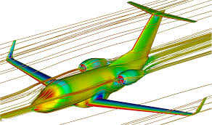
Application Fields
Numerical calculations and simulations
Particle physics
Computational fluid dynamics
Car crash simulations
Weather forecast
Commercial database applications
Non-numerical computations
Chess playing, theorem proving
Commercial database applications

Slide 19
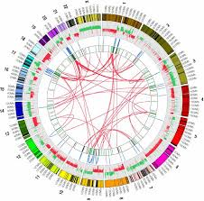
Continue
All fields of Bioinformatics
Computational genomics
Computational proteomics
Computational evolutionary biology
In general
Everything that runs between 1 and 10.000 days
Everything that uses high volumes of data

Slide 20

Measures
Mega (10⁶) – Giga (10⁹) – Tera (10¹²) – Peta (10¹⁵) – Exa (10¹⁸)
Computational Performance (Flop/s)
Flop/s = floating point operations per second
Modern processor: 3 GFlop/s
Supercomputer: 1.88 ExaFlop/s (factor 1,000,000,000)
Network performance (Byte/s)
Personal computer: 10/100 MByte/s
Supercomputer networks: gigabytes/s

Slide 21
Types of computing problems
Tightly Coupled
1 + 1 = X
X + 2 = Y
Y + 3 = Z
N + Z = W
Embarrassingly Parallel
1 + 1 = X
2 + 2 = Y
3 + 3 = Z
N + N = W

Slide 22
Generic bioinformatics use case
Scientist has a problem
She does not want or need to run ONE parallel application stretching across a 100 CPU cluster
She wants to run one standalone program 100,000 or 1,000,000 times with slightly different input and output values
Embarrassingly Parallel
1 + 1 = X
2 + 2 = Y
3 + 3 = Z
N + N = W

Slide 23
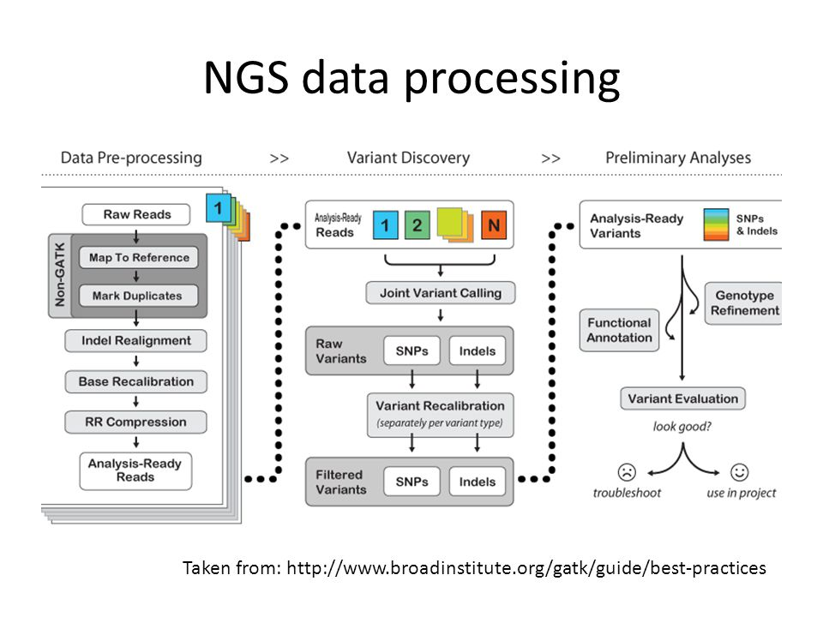
NGS data processing is embarrassingly parallel

Slide 24
Split target databases & by query
>Sequence1
>Sequence2
DB
Result
>Sequence3
>SequenceN
DB
DB
Result
Result
DB
DB
Result
Result
DB
DB
Result
Result

Slide 25
Embarrassingly parallel tasks
lend themselves well to
“high performance computing”

Slide 26
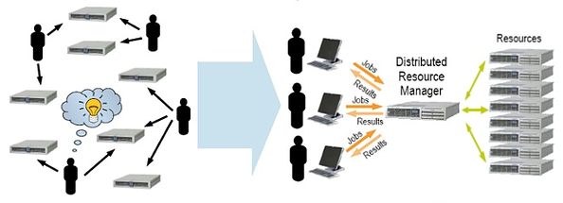
High Performance Linux cluster Job management
Unmanaged
Managed by SLURM

Slide 27
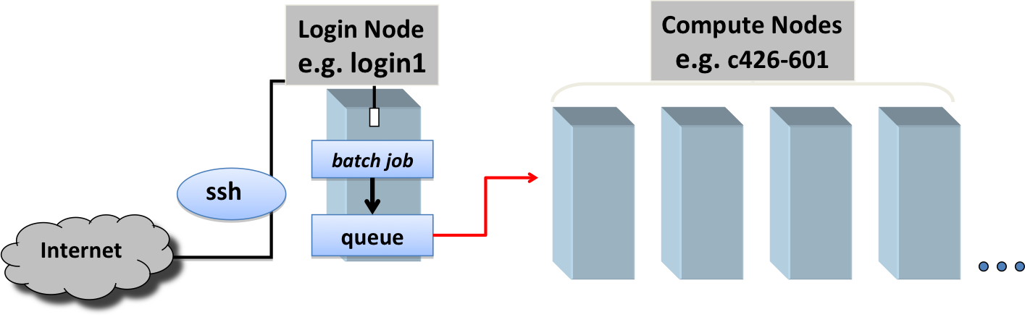
Job Submission with SLURM

Slide 28

SLURM workload manager
Slurm is an open source, fault-tolerant, and highly scalable cluster management and job scheduling system for large and small Linux clusters
Slurm has three key functions:
Allocates exclusive and/or non-exclusive access to resources (compute nodes)
Provides a framework for starting, executing, and monitoring work processes on the set of allocated nodes
Arbitrates contention for resources by managing a queue of pending work

Slide 29
SLURM commands
sinfo - reports the state of partitions and nodes managed by SLURM
smap - reports state information for jobs, partitions, and nodes
sbatch - is used to submit a job script for later execution
squeue - reports the state of jobs or job steps.
srun - is used to submit a job for execution in real time
scancel - is used to stop a job early.

Slide 30
Job Submission with SLURM
The user “submits” the job to the RMS e.g. issuing
“sbatch jobscript.pbs”
The user can control the job
sbatch: submit
sinfo: poll status information
scancel: cancel job
It is the task of the resource management system to start a job on the required resources
Current system state is taken into account
Can also submit interactive jobs
reserve CPU and memory for use

Slide 31
Example: SLURM Job Description
Simple job script:
whole job file is a shell script
#!/bin/bash #
#SBATCH -n 10 # Number of cores
#SBATCH -p longrun
#SBATCH --mem-per-cpu 1024
#SBATCH --mail-user=wgatua@hackbio.org
#Commands to run. Replace example below with your arguments and variables.
module load python/3.4.3
module load blastall/2.5.6
blastall –I query_seq.fa -d nr_database -p blastp
information for the RMS are comments
the actual job is started in the script

Slide 32

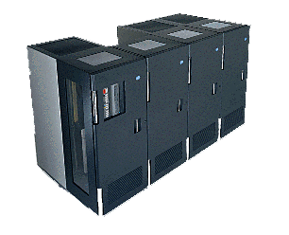
Job Steps
A user job enters a job queue,
the scheduler (its strategy) decides on start time and resource allocation of the job.
Scheduler
time
Job Execution Management
Schedule
User
Job Description
Job-Queue
Node Job Mgmt
Node Job Mgmt
Node Job Mgmt
HPC Computer

Slide 33
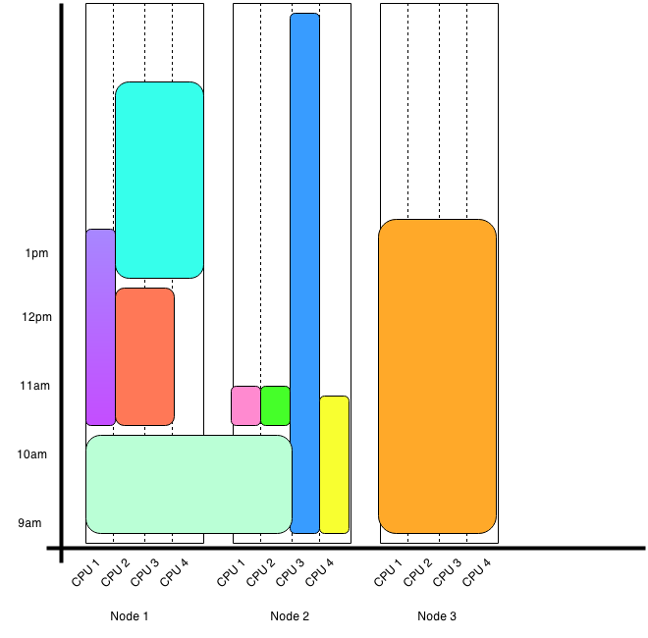
SLURM Job Scheduler
Priority factors
age: how long the job has been waiting in the queue,
fair share: a measure of past usage of the cluster by the user,
size: the number of CPUs a job requests

Slide 34
Job Classifications
Batch Jobs vs interactive jobs
batch jobs are queued until execution
interactive jobs need immediate resource allocation
Parallel vs. sequential jobs
a job requires several processing nodes in parallel
The majority of HPC installations are used to run batch jobs in space-sharing mode!
a job is not influenced by other co-allocated jobs
the assigned processors, node memory, caches etc. are exclusively available for a single job.
overhead for context switches is minimized
important aspects for parallel applications

Slide 35
Accelerators and Many Integrated Cores
Typical CPUs are not very energy efficient
Meant to be general purpose, which requires lots of pieces to the chip
Accelerators package much more FLOP capabilities with less energy consumption
Not exactly general purpose
Always requires more work from the programmer
Performance improvements and application porting may take significant effort

Slide 36



GPU Accelerators
A graphics processing unit (GPU) as accelerators
NVIDIA GPUs can be used to perform calculations
Latest Turing generation offer 130 TFLOPs in a single package

Slide 37
cudasw.sbatch
#!/bin/env bash
#SBATCH --job-name=cudasw
#SBATCH --nodes=1
#SBATCH --ntasks-per-node=20
#SBATCH -p longrun
#SBATCH -w keklf-cls01
#SBATCH --gres=gpu:1
#SBATCH --mail-user wgatua@hackbio.org
#Command to run.
module load cudasw/v3.1.1
cudasw -query Queries/all.fasta –db uniprot_sprot.fasta -use_single 1

Slide 38
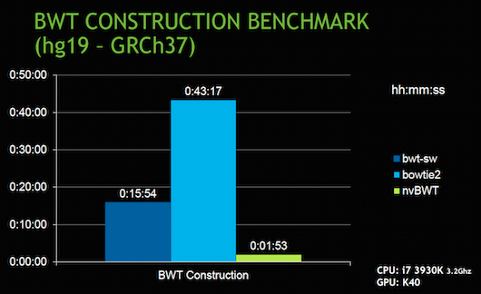
GPU accelerated Bowtie2
BWT-SW and Bowtie2 compared to nvBWT on human reference genome build hg19.
nvBWT about 8X and 21X faster than BWT-SW and Bowtie2, respectively.

Slide 39
Access to HPC
Users access the HPC server through ssh connection to their user accounts.
User account will only be activated after a short induction training session.
Only you have access to your directory and workspace.

Slide 40
Python Programming
Objectives
Installation of python and jupyter notebooks
Python syntax
Data types
Variable Assignments
Arithmetic’s
Data structures

Slide 41

Thank you

